Slide 1


Covid Cases and Deaths Worldwide Analysis
Nithya Sree Kata
Rushikeshwar Reddy Gaddam
Rohith Gaddam
Ashwanth Reddy vavilala

Slide 2
Introduction
The Covid-19 pandemic has caused significant damage across the globe, impacting millions of lives. As the world continues to grapple with this unprecedented health crisis, it is important to analyze and understand the data related to Covid-19 cases, deaths, and recoveries in different countries around the world.
This project aims to provide insights into the impact of Covid-19 on a global scale by analyzing and visualizing countrywide details of Covid-19 cases, deaths, and recoveries obtained from Kaggle.

Slide 3

Goals
Analyze and visualize the data to provide insights related to the Covid-19 pandemic.
Answer some of the important questions related to Covid-19.
Understand the impact of Covid-19 on different countries worldwide.

Slide 4

Covid-19 Cases and Deaths Worldwide
One of the key objectives of this project is to analyze the data related to Covid-19 cases and deaths worldwide. By doing so, we can identify the countries that have been hit hardest by the pandemic and gain a better understanding of the factors that contribute to the spread of the virus.
Through our analysis, we found that the United States has the highest number of Covid-19 cases and deaths, followed by India and Brazil. However, when we look at the death rate per capita, we see that some smaller countries such as San Marino and Belgium have been hit particularly hard.

Slide 5

Trends in Covid-19 Deaths
Another important aspect of this project is to analyze the trends in Covid-19 deaths over the past two years. By doing so, we can identify whether the situation is improving or worsening in different countries and regions.
Our analysis shows that while there was a significant increase in Covid-19 deaths in the early months of the pandemic, many countries have been able to bring down the death rates through effective measures such as lockdowns and vaccination campaigns. However, some countries such as Brazil and Mexico continue to experience high death rates due to the ongoing spread of the virus.

Slide 6

Methodology
The project will collect data from reliable sources such as World Health Organization (WHO), John Hopkins University, and other reputable organizations. The data will be cleaned and processed using Python programming language and Pandas library.
The analysis will include descriptive statistics, correlation analysis, and regression analysis to identify the patterns and trends in the data. The results will be presented through visualizations such as line charts, bar graphs, and heat maps to support the analysis.

Slide 7
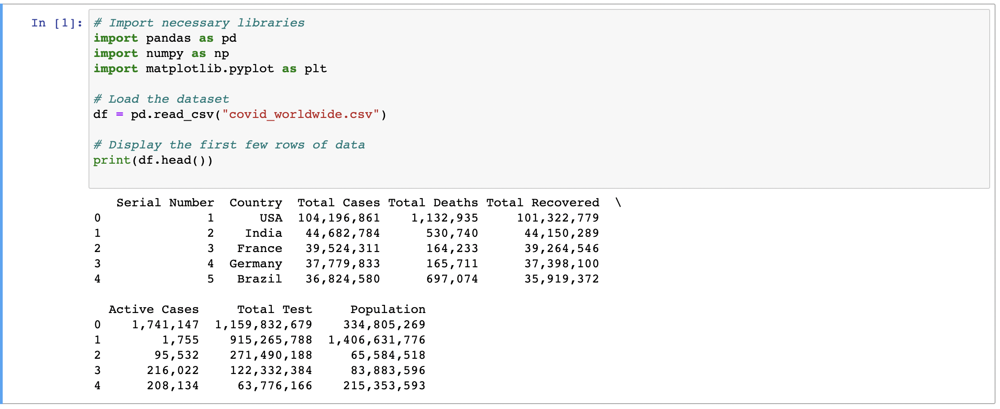

Slide 8

Importing Python Libraries And Loading the Dataset
To manipulate and visualize data effectively, we need to import necessary Python libraries such as Pandas, NumPy, and Matplotlib. Pandas is used for data manipulation and analysis, NumPy provides support for large multi-dimensional arrays and matrices, and Matplotlib helps us create various types of charts and graphs. By importing these libraries, we can use their functions and methods to manipulate and visualize the data effectively.
To load the Covid-19 dataset into a Pandas DataFrame, we need to import the necessary libraries and use the read_csv() method provided by Pandas to load the dataset from a CSV file. After loading the dataset, we can use the head() method to display the top n rows of the DataFrame, get an idea of its structure, and identify any missing or incorrect values. DataFrame is a two-dimensional table-like data structure with rows and columns.

Slide 9
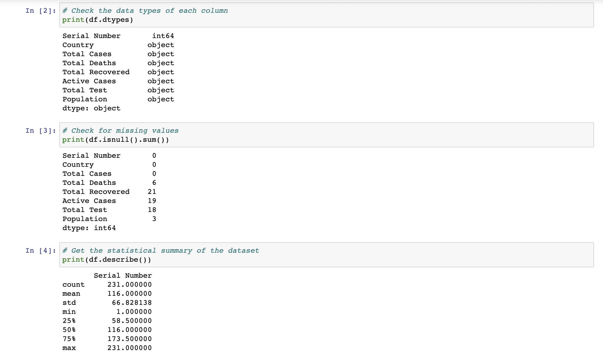

Slide 10

Exploratory Data Analysis And Data Cleaning
Exploratory data analysis (EDA) involves visualizing and summarizing the data to understand its distribution, patterns, and relationships. We can use various visualization techniques such as histograms, scatter plots, and heat maps to explore the data. By performing EDA, we can identify outliers, missing values, or inconsistencies in the data, which can help us clean the data and prepare it for further analysis.
After performing EDA, we may identify some data cleaning requirements to handle missing or incorrect values, remove duplicates, and transform the data to make it suitable for analysis. Data cleaning involves various techniques such as imputation, deletion, and normalization. Cleaning the data helps us ensure that our analysis is accurate and meaningful and avoid biases or errors that may arise due to incomplete or incorrect data.

Slide 11

Visualizations
Visualizations are an important part of any project analysis. They help to communicate complex data in a simple and understandable way. The visualizations should be well-designed and visually appealing, with clear labels and titles.
The visualizations should also be interactive, allowing the user to explore the data in more detail. The visualizations should be generated using Python libraries such as Matplotlib and Seaborn, which provide a wide range of visualization options.

Slide 12
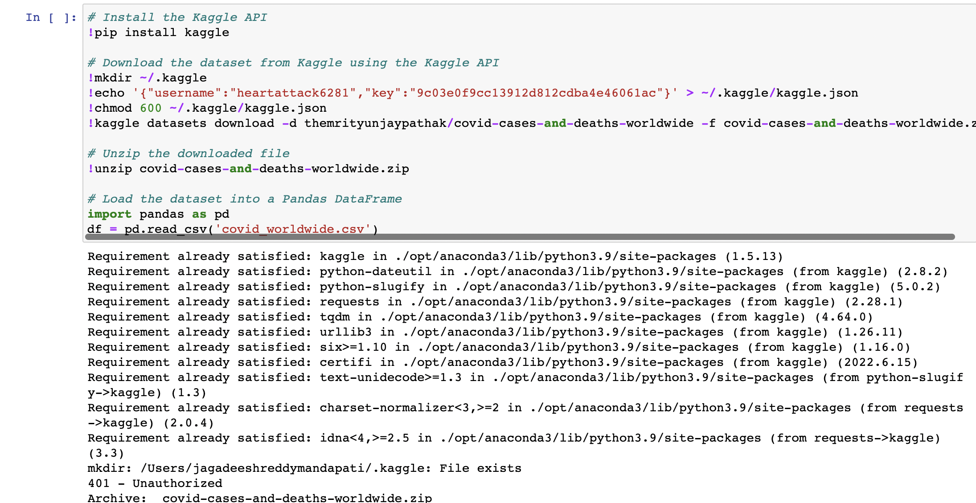

Slide 13

Optimizing the code and making visualizations
To optimize the code, we can use more efficient algorithms, leverage parallel processing capabilities, and use vectorized operations. We can further optimize the code by reducing unnecessary computations and using memory-efficient data structures. Advanced visualization techniques like geographic maps, time series plots, stacked bar charts, heatmaps, and interactive dashboards can be used to provide deeper insights into the data. Using interactive visualization tools like Plotly and Bokeh can also help in presenting the data in an engaging and interactive manner. Sophisticated statistical models can also be used to analyze the data and visualize the results.

Slide 14
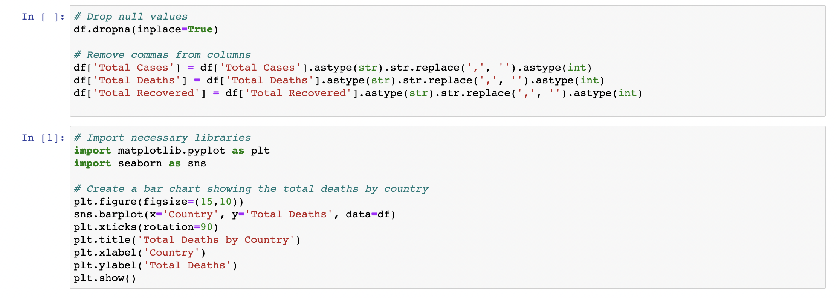

Slide 15

Findings
The analysis revealed that the United States, Brazil, and India were the countries with the highest number of confirmed cases and deaths due to Covid-19. The analysis also showed that countries with higher population density and lower healthcare infrastructure were more vulnerable to the virus.
The analysis further revealed that countries that implemented strict lockdown measures and invested in healthcare infrastructure were able to control the spread of the virus more effectively than countries that did not take such measures. The findings of the analysis can help policymakers make informed decisions to combat the pandemic.

Slide 16
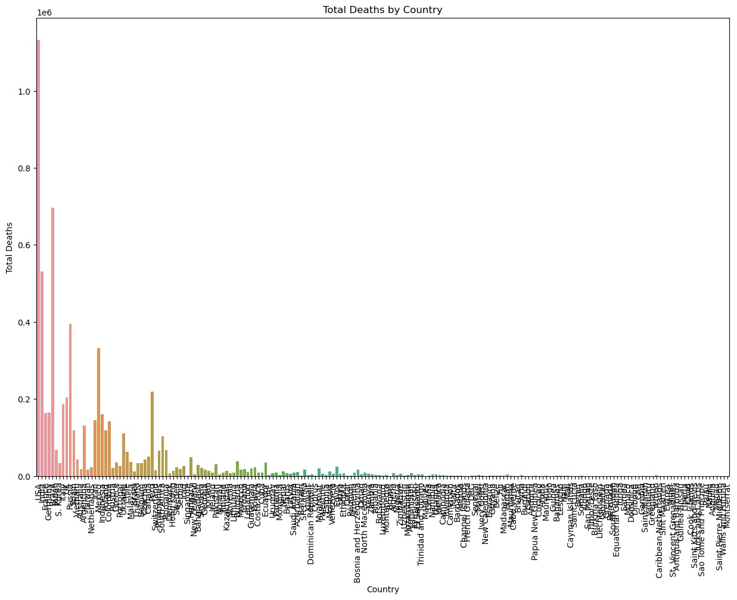

Slide 17

Limitations
The analysis was limited by the availability and quality of the data. Some countries may not have reported accurate data due to various reasons such as lack of resources or political reasons. The analysis was also limited by the fact that the pandemic is an ongoing event, and the situation is constantly changing.
The analysis did not take into account the differences in demographics, culture, and social norms among different countries, which could have influenced the spread of the virus. Therefore, the findings of the analysis should be interpreted with caution.

Slide 18

Conclusion
In conclusion, this project provides valuable insights into the impact of Covid-19 on different countries around the world. By analyzing and visualizing the data related to Covid-19 cases, deaths, and recoveries, we can identify the countries that have been hit hardest by the pandemic and understand the factors that contribute to the spread of the virus.
Moving forward, it is important for governments and healthcare organizations to use this data to inform their policies and strategies for containing the spread of Covid-19 and providing adequate medical care for those affected.

Slide 19

Thankyou!

